Slide 1
TERM PROJECT AI ASSISTED PM
Duru KARACAN 202128022
Dilara Çağla BANKO 202128201

Slide 2
CONTENTS
Introduction
SRS Review and Corrections
UML Creation
Work Breakdown Structure (WBS)
Task Dependencies
Task Estimations
Gantt Chart Creation
Risk Identification
Conclusion

Slide 3
Introduction
This project focuses on advanced AI tools to enhance project management processes.
We used three AI tools: ChatGPT, Claude, and Google GEMINI, to assist in various project tasks.
The primary objective is to refine a not-perfect Plant Disease SRS (Software Requirements Specification) document and ensure the project's management tasks are carried out efficiently.
These tasks include: SRS Review and Corrections, UML Creation, WBS Development, Setting Task Dependencies, Task Estimations using 3-point techniques, Gantt Chart Creation, Risk Identification

Slide 4
SRS Review and Corrections
OUR APPROACH TO ANALYZE SRS
To analyze the Plant Disease SRS effectively, we used this carefully crafted prompt
INITIAL PROMPT
As a project manager analyzing this SRS document in detail, conduct a section-by-section review starting with Section A, followed by A1. Purpose, and so on. Identify any missing requirements, conflicting statements, ambiguous terms, missing use cases, incorrect UML diagrams, logical inconsistencies, or technical inaccuracies. For each section, present your findings by showing the exact sentence from the SRS document and clearly explaining the identified problem along with the reasoning behind it. Do not change the original text in the SRS. Wait for my approval before proceeding to the next section.
ITERATIVE PROMPTS
move to X section

Slide 5
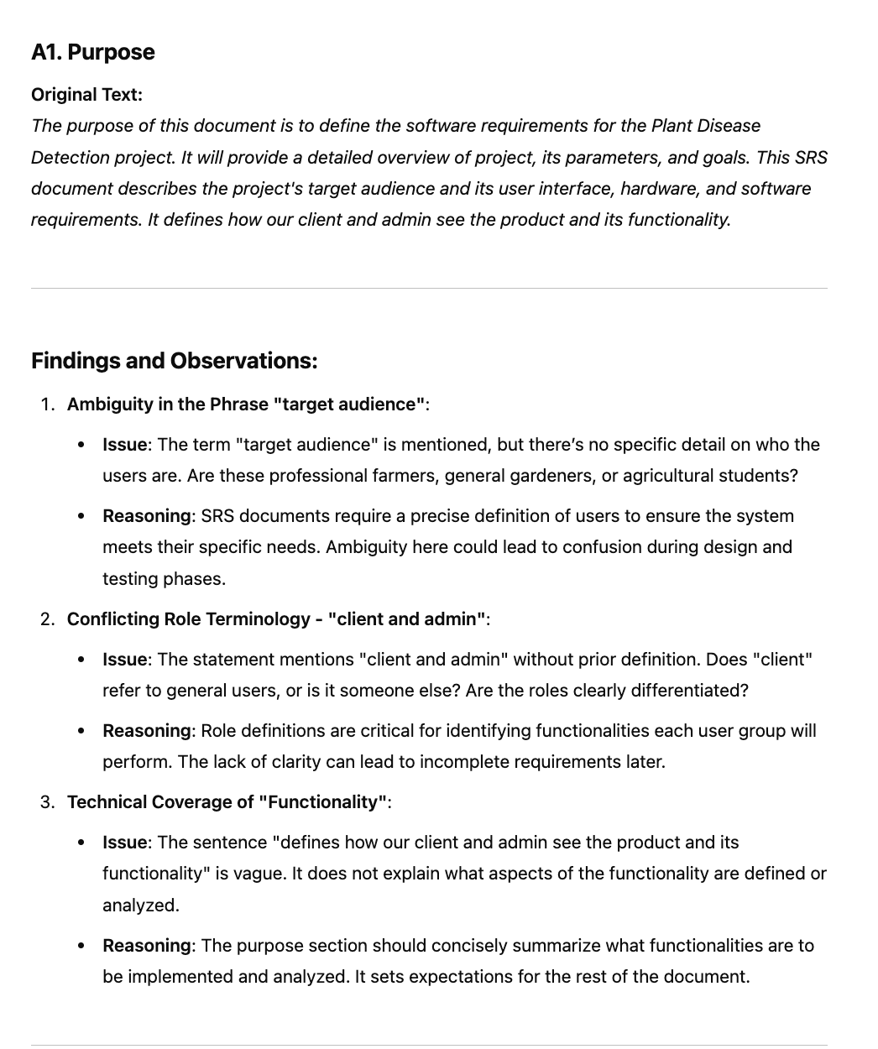
SRS Review and Corrections
GPTs RESPONSE:
Using the provided prompt, GPT analyzed the Plant Disease SRS document section by section, delivering a detailed and structured review. The analysis identified key issues along with their reasoning for each section.
Next Steps:
We will use these insights and findings to correct the SRS and ensure that the document is clear, consistent, and complete.

Slide 6
SRS Review and Corrections
OUR APPROACH TO CORRECTING THE SRS
To effectively correct the Plant Disease SRS, we analyzed each section systematically using GPT’s responses. Based on the identified issues and their reasoning, we crafted a tailored prompt to rewrite the problematic sections of the SRS.
PROMPT FOR CORRECTING THE SRS
Rewrite the original text with the corrected text accordingly.
ITERATIVE PROMPTS
There was no need for additional iterative prompts. We relied on GPT’s responses to address the issues and applied the correction prompt directly for rewriting the SRS.

Slide 7
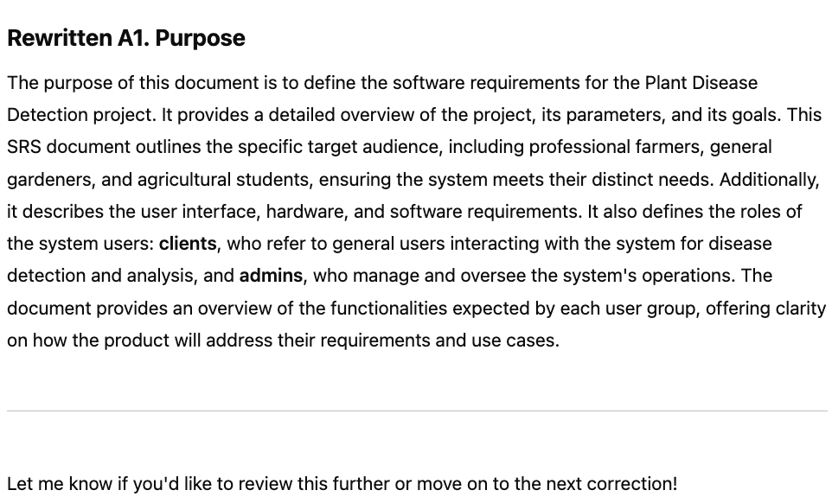
SRS Review and Corrections
GPTs RESPONSE:
GPT provided a corrected version of each section, helping us address key issues in the Plant Disease SRS. However, the responses were not always perfect. While analyzing subsequent sections, we noticed that GPT occasionally used vague terms or redundant phrases (e.g., "such as," "like that"). This required careful review and additional refinement on our part.

Slide 8
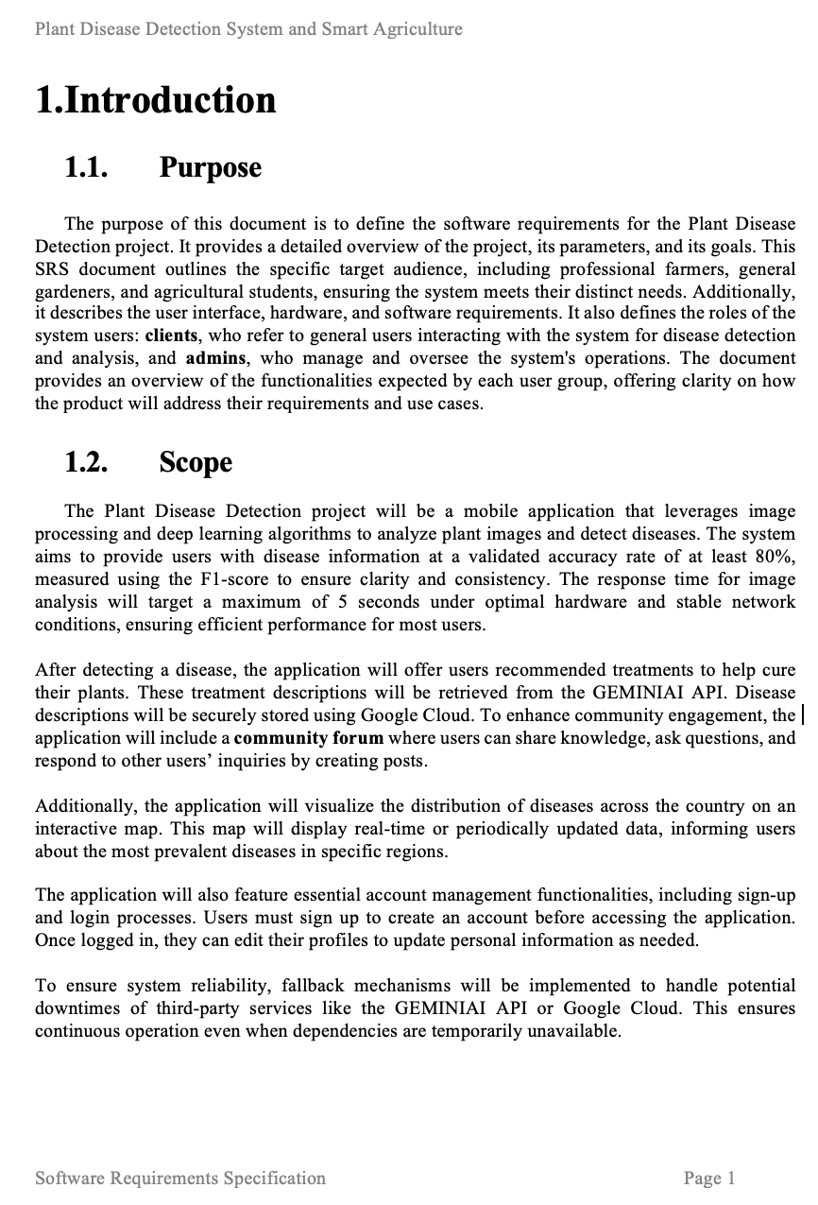
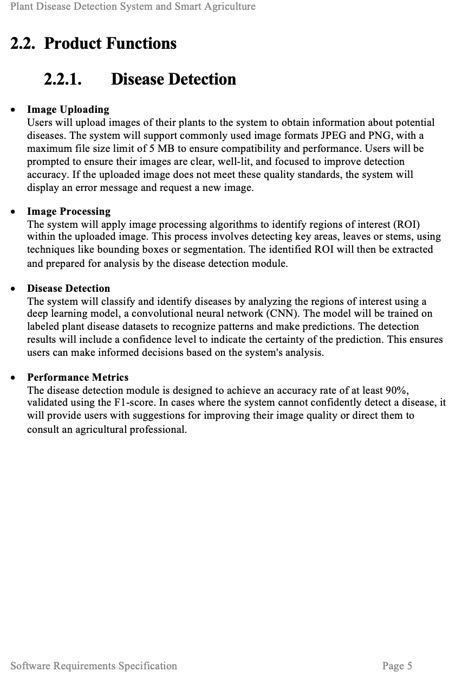

Slide 9
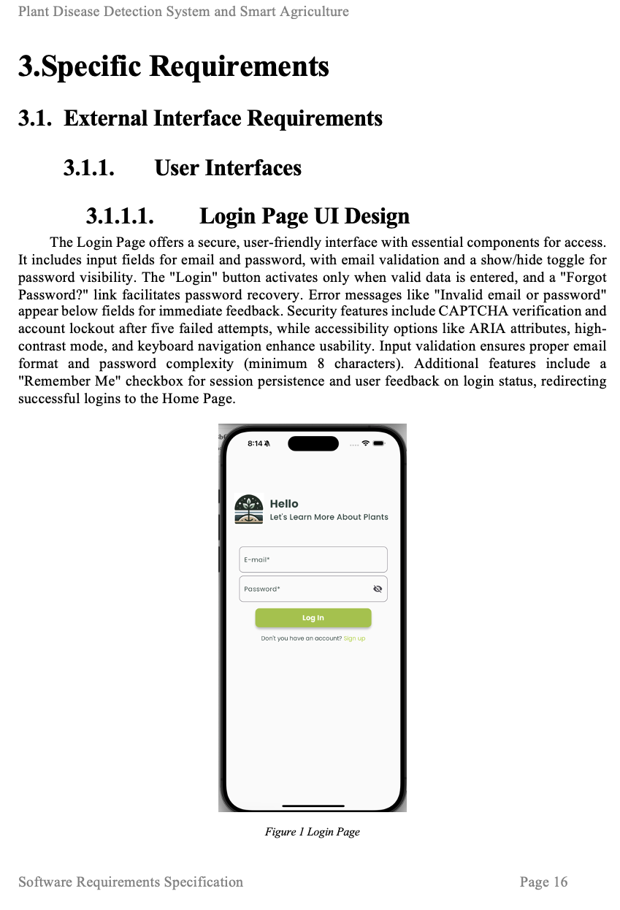
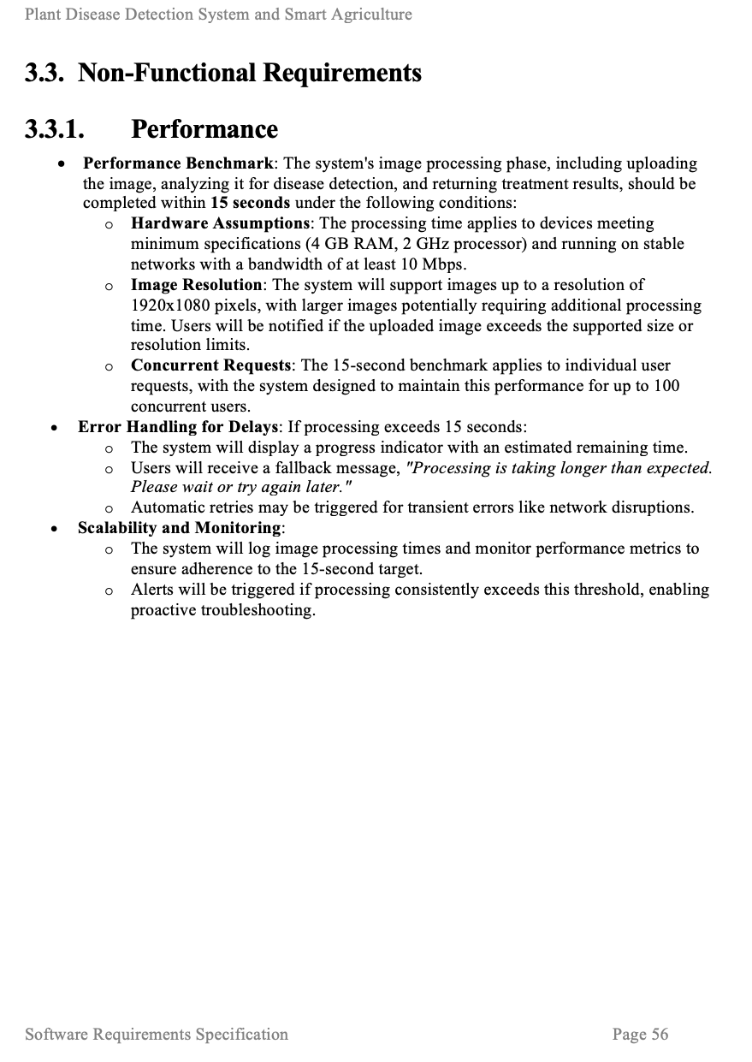

Slide 10
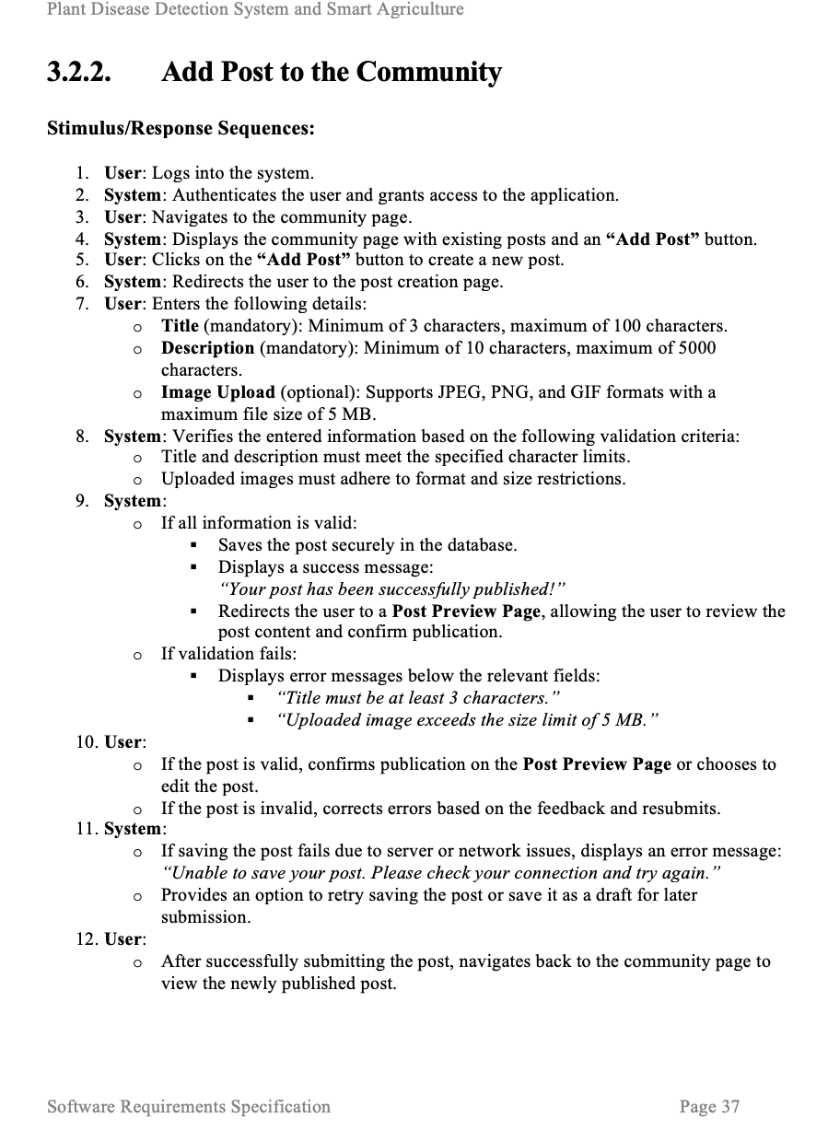
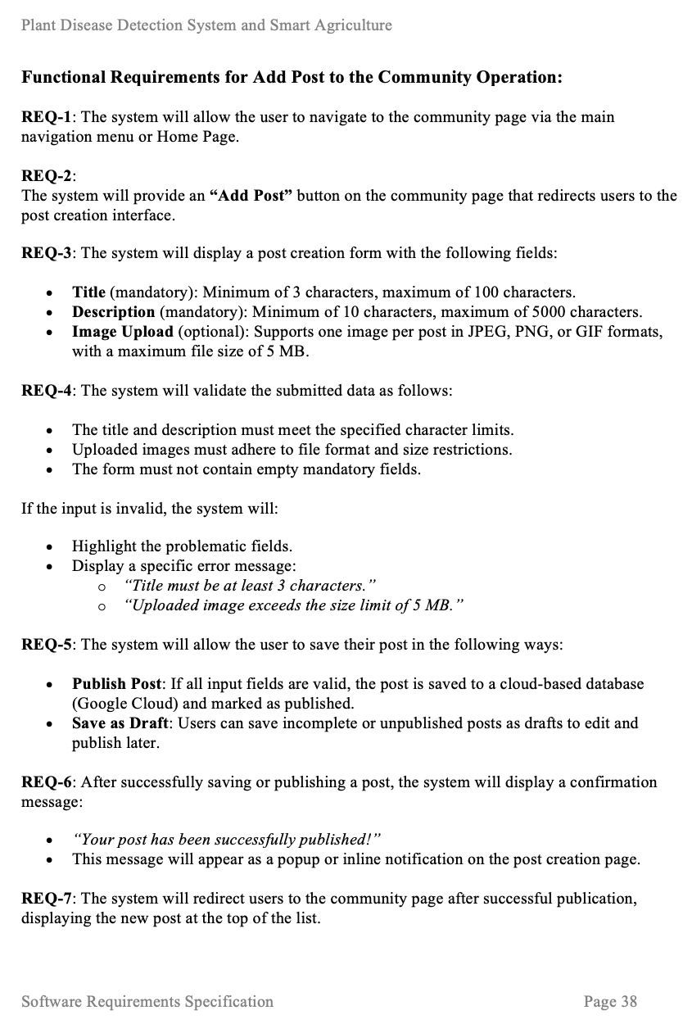

Slide 11
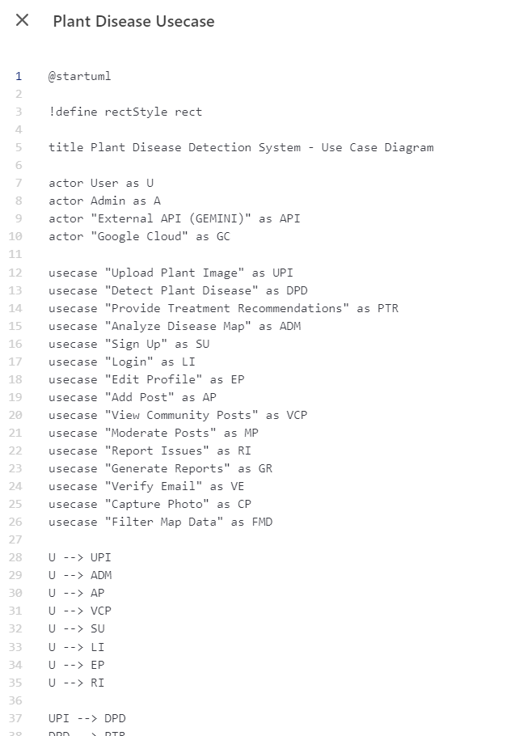
UML Creation
USE CASE DIAGRAM
We asked GPT to analyze the rewritten SRS document and prepare PlantUML code to generate the Use Case Diagram.
INITIAL PROMPT
Below is a completed Software Requirements Specification (SRS) document. Based on this SRS, perform the following tasks in order:
Use Case Diagram: Identify all the actors (users or systems) and the use cases they are involved in from the SRS. Define the relationships between actors and use cases (e.g., "include" and "extend" relationships). Based on these relationships, generate a Use Case Diagram using PlantUML syntax.
Rules: Generate diagrams in PlantUML code. Start each diagram's PlantUML code with the appropriate tags (e.g., @startuml and @enduml).
ITERATIVE PROMPTS
There was no need for additional iterative prompts.

Slide 12
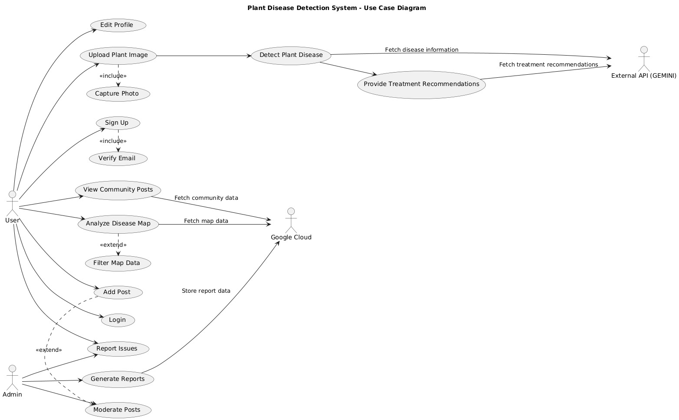

Slide 13
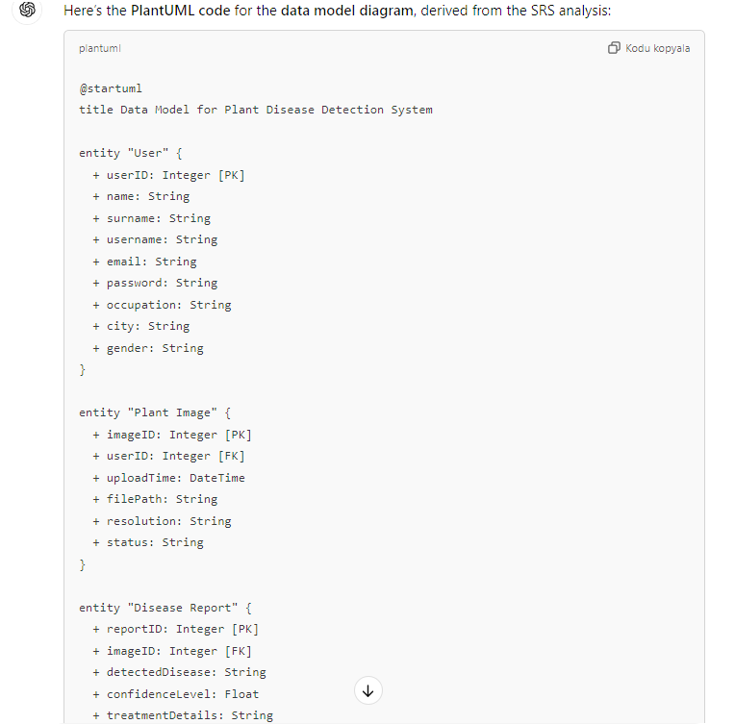
UML Creation
Data Model DIAGRAM
We asked GPT to create a Data Model Diagram and prepare PlantUML code. (It continued with its analysis to create a Use Case Diagram.)
INITIAL PROMPT
Create PlantUML code for the data model diagram by re-analyzing the SRS.
ITERATIVE PROMPTS
There was no need for additional iterative prompts.

Slide 14
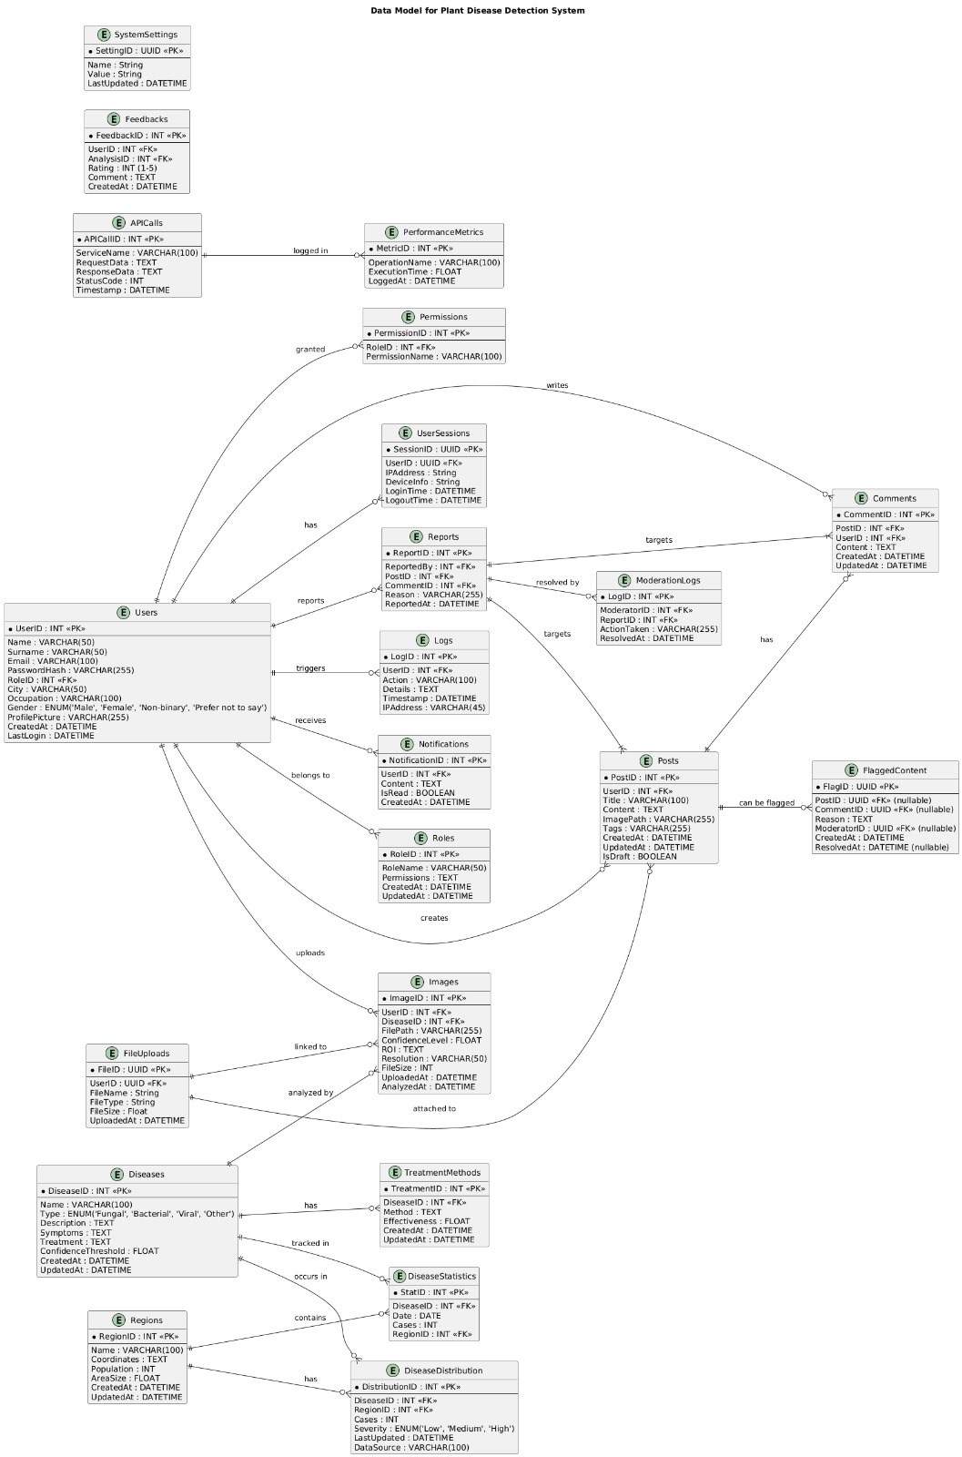

Slide 15
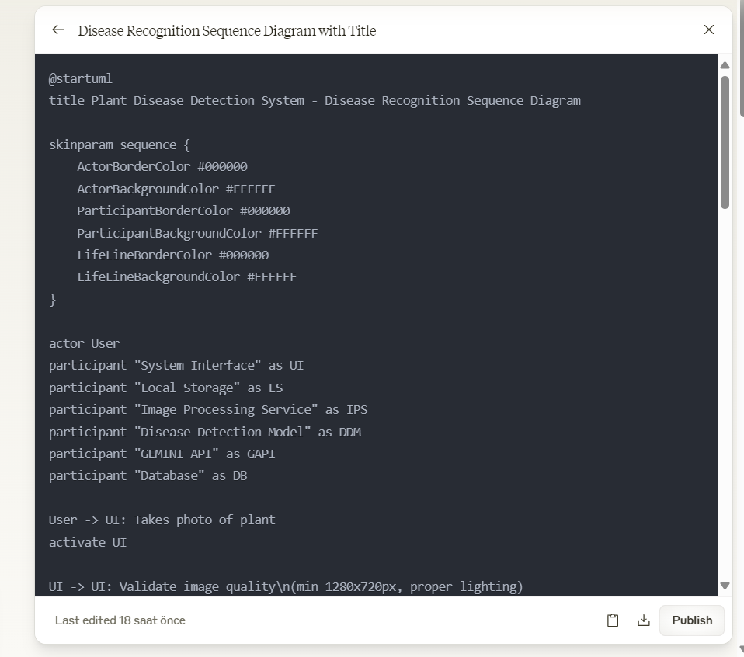
UML Creation
SEQUENCE DIAGRAM
We asked CLAUDE to analyze the rewritten SRS document and prepare PlantUML code to generate the Sequence Diagram.
INITIAL PROMPT
Examine the SRS thoroughly and write PlantUML code for the appropriate sequence diagram.
ITERATIVE PROMPTS
There was no need for additional iterative prompts.

Slide 16
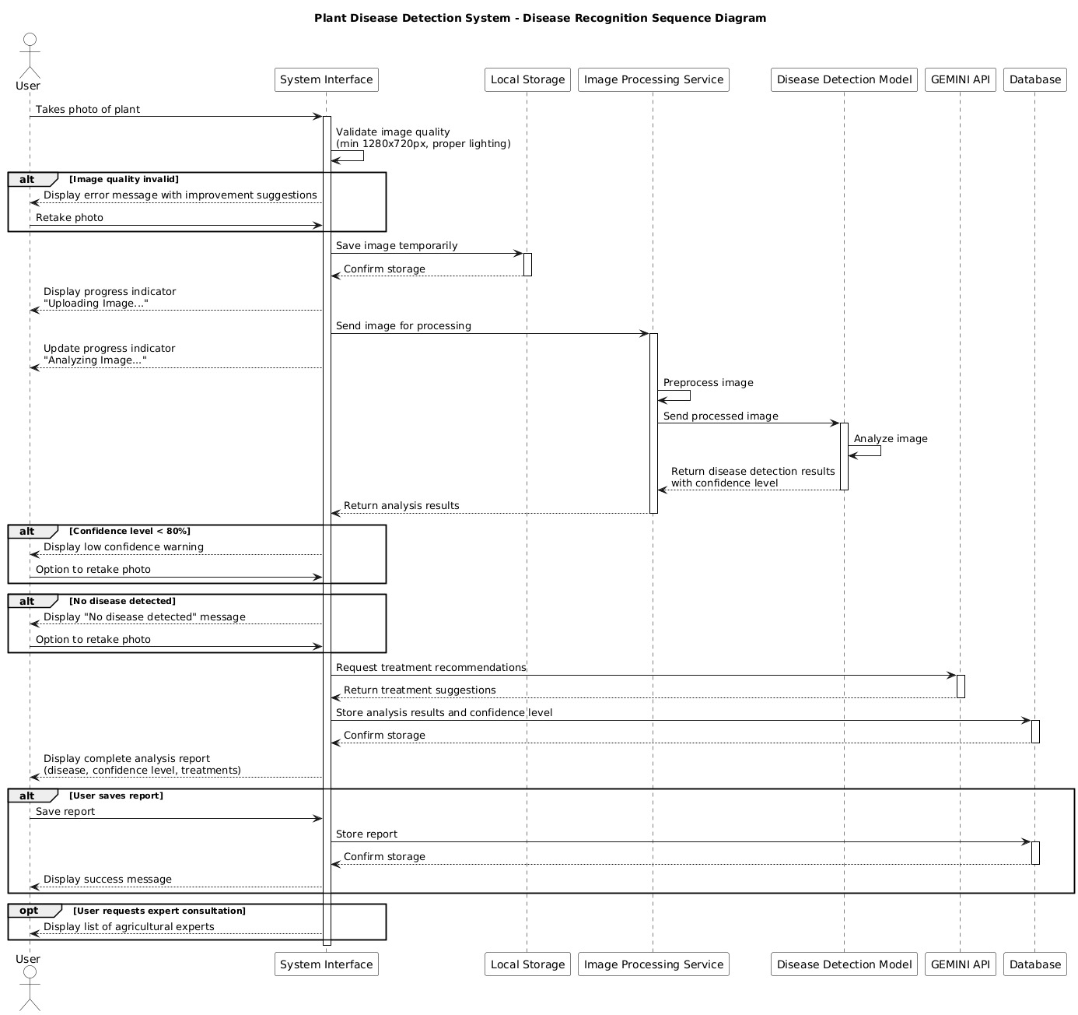

Slide 17
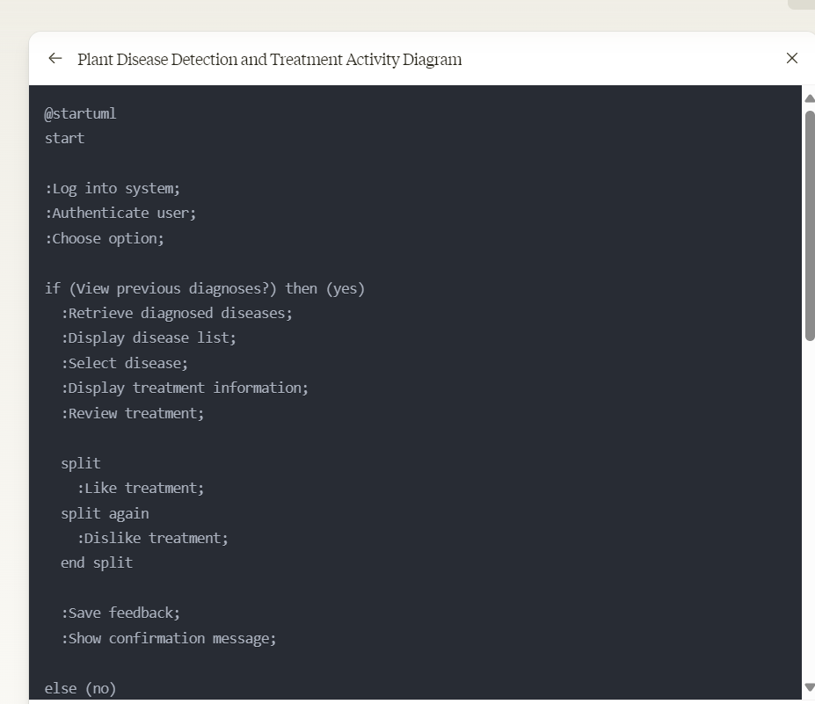
UML Creation
One of the responses is as follows:
ACTIVITY DIAGRAM
We asked CLAUDE to analyze whichever Functional Requirement we are sending and prepare the PlantUML code to create its Activity Diagram. We continued in the same way for all Activity Diagrams.
INITIAL PROMPT
As a project manager, write PlantUML code for the activity diagram of the Functional Requirement below.
ITERATIVE PROMPTS
The same prompt was used for all functional requirements in order.

Slide 18
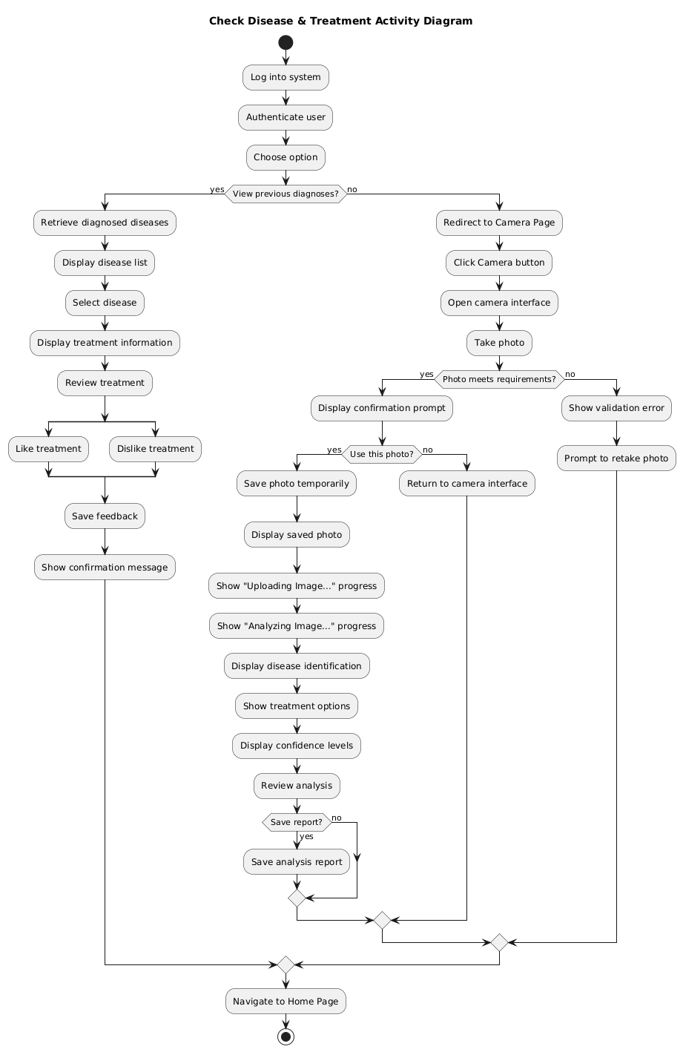

Slide 19
Work Breakdown Structure WBS
OUR APPROACH TO BREAKDOWN THE TASKS FOR WBS
We aimed to break down the Plant Disease SRS into manageable task modules and corresponding tasks. This process allowed us to organize tasks systematically and assign responsibilities clearly. The following prompt was used:
INITIAL PROMPT
Analyze the given SRS document as a project manager and break it down into task modules. Then, list only the titles of the corresponding tasks under the title of their modules. Assign each task to the respective person assuming the tasks would be done by the following roles: PM: Ayşe, TTL: İrem, Mobile Dev: Efe, AI Dev: Irmak, DevOps: Emre, QA: Pamir. Complete the analysis module by module, starting with Preliminary Work, and seek approval before proceeding to the next module. Ensure that the output includes only task titles with the assigned person written next to the task within the module title. Use the module structure: Preliminary Work, Machine Learning & AI Module, Web (Backend/Frontend), Non-Dev Tasks, and DevOps.
ITERATIVE PROMPTS: next
We used the following prompt to transition to the next task module and identify the corresponding tasks under their respective module titles.

Slide 20
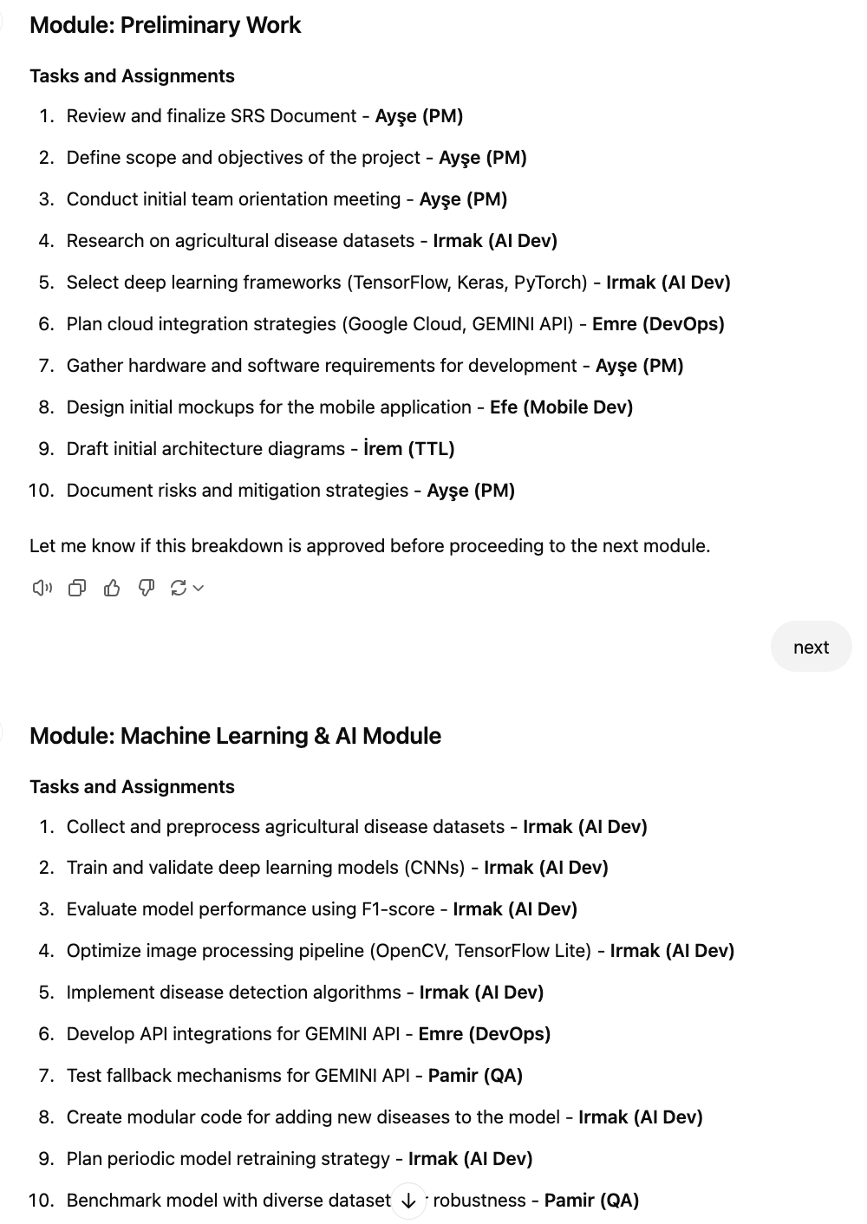
Work Breakdown Structure WBS
GPTs RESPONSE:
At this stage, we found GPT’s response effective for a first attempt, as it successfully understood the relationship between work modules and their corresponding tasks. However, some tasks were overly "atomic" and not entirely suitable for creating a clear WBS diagram. This issue was identified and corrected in subsequent iterations for improved output.
Next Steps:
We instructed GPT to generate PlantUML code for the WBS, enabling us to create a visual diagram of the breakdown structure.

Slide 21
Work Breakdown Structure WBS
PROMPT FOR CREATING WBS
Using the provided information, create a work breakdown chart in PlantUML code format for the Plant Disease Detection System project. Include the modules as nodes (Preliminary Work, Machine Learning & AI Module, Web (Backend/Frontend), Non-Dev Tasks, DevOps) and the corresponding atomic task titles assigned to the designated team members (PM: Ayşe, TTL: İrem, Mobile Dev: Efe, AI Dev: Irmak, DevOps: Emre, QA: Pamir). Ensure the chart is simple by grouping related tasks and listing only atomic tasks for each module in the work breakdown structure diagram. Write only the PlantUML code.
ITERATIVE PROMPTS
We did not use specific iterative prompts. Instead, we provided direct feedback such as: "Adjust this part" or "Change that section" to refine outputs for sections we found unsatisfactory.

Slide 22
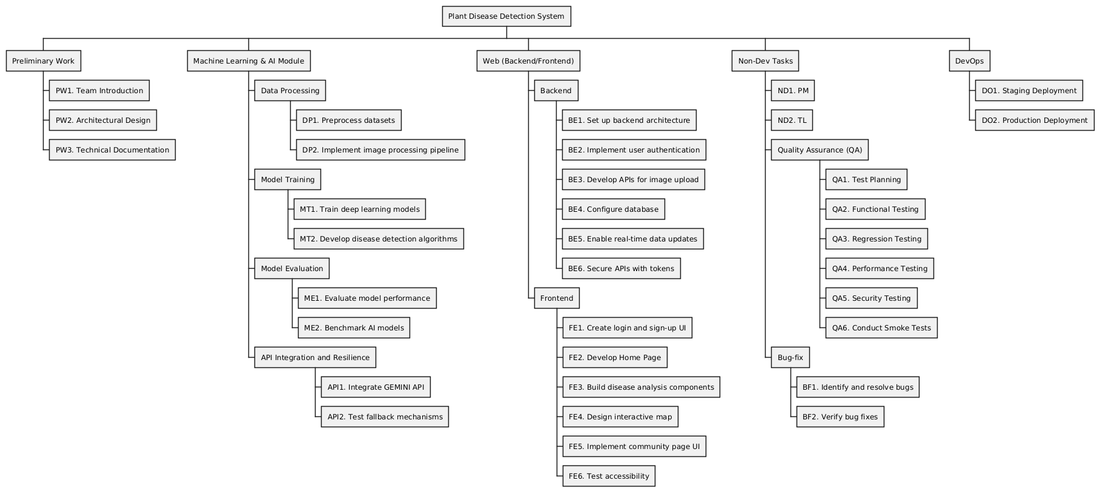
WBS – Final Result

Slide 23
Task Dependencies
OUR APPROACH TO CREATE TASK DEPENDENCIES
After creating the WBS for the Plant Disease Detection System, we used the following prompt to generate task dependencies. GPT effectively understood the tasks and dependencies based on the prior WBS and provided accurate results.
INITIAL PROMPT
As a project manager, create an Excel chart named "Dependencies of Plant Diseases" for work packages, including the related tasks with task codes and their dependencies. Use the following roles to determine task dependencies logically: PM: Ayşe, TTL: İrem, Mobile Dev: Efe, AI Dev: Irmak, DevOps: Emre, QA: Pamir. Ensure that tasks can have more than one dependency if required, and consider that a task cannot start until all its related predecessor tasks are completed. Additionally, ensure that the development phase begins only after PW3 (Preliminary Work: Technical Documentation) is completed. Maintain the following format:
Ensure dependencies are logically derived based on task flow, team roles, interdependencies, and the stated development phase condition. Write the chart in this format.
ITERATIVE PROMPTS
There was no need for iterative prompts for this task. GPT successfully created the dependencies chart on the first attempt.
Work Package | Task | Dependency
Preliminary Work | PW1. Team Introduction
Preliminary Work | PW2. Architectural Design | PW1
Preliminary Work | PW3. Technical Documentation | PW2

Slide 24
Task Dependencies – Final Result
Work Package | Task | Dependency | Role
Preliminary Work | PW1. Team Introduction |  | PM: Ayşe
Preliminary Work | PW2. Architectural Design | PW1 | PM: Ayşe
Preliminary Work | PW3. Technical Documentation | PW2 | PM: Ayşe
Machine Learning & AI Module - Data Processing | DP1. Preprocess datasets | PW3 | AI Dev: Irmak
Machine Learning & AI Module - Data Processing | DP2. Implement image processing pipeline | DP1 | AI Dev: Irmak
Machine Learning & AI Module - Model Training | MT1. Train deep learning models | DP2 | AI Dev: Irmak
Machine Learning & AI Module - Model Training | MT2. Develop disease detection algorithms | MT1 | AI Dev: Irmak
Machine Learning & AI Module - Model Evaluation | ME1. Evaluate model performance | MT2 | QA: Pamir
Machine Learning & AI Module - Model Evaluation | ME2. Benchmark AI models | ME1 | QA: Pamir
Machine Learning & AI Module - API Integration and Resilience | API1. Integrate GEMINI API | PW3 | DevOps: Emre
Machine Learning & AI Module - API Integration and Resilience | API2. Test fallback mechanisms | API1 | QA: Pamir
Web - Backend | BE1. Set up backend architecture | PW3 | TTL: İrem
Web - Backend | BE2. Implement user authentication | BE1 | TTL: İrem
Web - Backend | BE3. Develop APIs for image upload | BE2 | TTL: İrem
Web - Backend | BE4. Configure database | BE3 | TTL: İrem
Web - Backend | BE5. Enable real-time data updates | BE4 | TTL: İrem
Web - Backend | BE6. Secure APIs with tokens | BE5 | TTL: İrem
Web - Frontend | FE1. Create login and sign-up UI | PW3 | Mobile Dev: Efe
Web - Frontend | FE2. Develop Home Page | FE1 | Mobile Dev: Efe
Web - Frontend | FE3. Build disease analysis components | FE2 | Mobile Dev: Efe
Web - Frontend | FE4. Design interactive map | FE3 | Mobile Dev: Efe
Web - Frontend | FE5. Implement community page UI | FE4 | Mobile Dev: Efe
Web - Frontend | FE6. Test accessibility | FE5 | Mobile Dev: Efe
Non-Dev Tasks | ND1. PM |  | PM: Ayşe
Non-Dev Tasks | ND2. TL |  | TTL: İrem
Non-Dev Tasks - Quality Assurance (QA) | QA1. Test Planning | PW3 | QA: Pamir
Non-Dev Tasks - Quality Assurance (QA) | QA2. Functional Testing | QA1 | QA: Pamir
Non-Dev Tasks - Quality Assurance (QA) | QA3. Regression Testing | QA2 | QA: Pamir
Non-Dev Tasks - Quality Assurance (QA) | QA4. Performance Testing | QA3 | QA: Pamir
Non-Dev Tasks - Quality Assurance (QA) | QA5. Security Testing | QA4 | QA: Pamir
Non-Dev Tasks - Quality Assurance (QA) | QA6. Conduct Smoke Tests | QA5 | QA: Pamir
Non-Dev Tasks - Bug-fix | BF1. Identify and resolve bugs | QA1, QA2 | QA: Pamir
Non-Dev Tasks - Bug-fix | BF2. Verify bug fixes | QA3, QA4 | QA: Pamir
DevOps | DO1. Staging Deployment | QA5, QA6 | DevOps: Emre
DevOps | DO2. Production Deployment | BF1 | DevOps: Emre

Slide 25
Task Estimations
OUR APPROACH TO CREATE TASK ESTIMATIONS
After creating the Task Dependencies for the Plant Disease Detection System, we used the following prompt to generate task estimations. GPT provided three-point estimations (Optimistic, Realistic, Pessimistic) for each task, giving us a comprehensive view of potential timeframes for completion.
INITIAL PROMPT
Create a chart for three-point estimations (optimistic, realistic, pessimistic) for the tasks in the "Dependencies of Plant Diseases" chart. For example, the three-point estimations for Preliminary Work should look like this:
After listing all tasks and their three-point estimations, calculate and add the total work for each estimation (Optimistic Total, Realistic Total, Pessimistic Total) in a line above the "Non-Dev Tasks" section. Ensure to list only the task titles under "Non-Dev Tasks" without leaving blank spaces for their estimations. Write the chart in the specified format.
ITERATIVE PROMPTS
We instructed GPT to leave blank spaces for estimations related to Non-Dev Tasks, as we needed coefficients for those tasks. GPT then created coefficients and filled the blanks accordingly, ensuring consistency and accuracy in the estimations.
Task |  | Optimistic Hour | Realistic Hour | Pessimistic Hour
Preliminary Work
PW1. Team Introduction |  | 1 | 2 | 3
PW2. Architectural Design |  | 5 | 8 | 12
PW3. Technical Documentation |  | 8 | 12 | 16

Slide 26
Task Estimations
PROMPT FOR NONDEV TASK ESTIMATIONS
Determine the coefficients for each Non-dev task, the coefficients will represent the proportion of time each task should take relative to the total development work. The coefficients are based on the importance, complexity, and typical time requirements for each type of task in a project. Here’s an example of the coefficient assignment for each task in the Non-Dev Tasks section:
ITERATIVE PROMPTS
Using the provided table, calculate the estimated hours for each task in the "Non-Dev Tasks" section. For each task, multiply the corresponding coefficient by the Total (Optimistic, Realistic, Pessimistic) values. Write the resulting values in the related cells under Optimistic, Realistic, and Pessimistic columns for each task. Ensure the results are rounded to two decimal places and presented in the same table format.
Non-Dev Tasks
ND1. PM | 0.05
ND2. TL | 0.07

Slide 27
Task Estimations Final Result

Slide 28
Gantt Chart Creation
OUR APPROACH TO CREATE GANTT CHART
Now that GPT knows the task dependencies and task estimations, we asked GPT to create a Gantt chart for the project. We specifically instructed GPT to use Python and libraries like Matplotlib or Plotly for visualizing the Gantt chart effectively. This approach ensured that the Gantt chart was both clear and easy to interpret.
INITIAL PROMPT
Based on the provided chart and dependencies in the uploaded file, create a Gantt chart for the project using Python(Use Python libraries like matplotlib or plotly). Ensure task assignments adhere to the specified team members (PM: Ayşe, TTL: İrem, Mobile Dev: Efe, AI Dev: Irmak, DevOps: Emre, QA: Pamir) while maintaining resource leveling. One person can work on only one task at a time. Consider task dependencies and duration to schedule tasks logically. Present the Gantt chart in a clear and structured format that aligns with the project timeline and resource allocation. write just the related python code.
ITERATIVE PROMPTS
There was no need for iterative prompts.
GPT successfully created an interactive application (Project_Gantt_Chart.html) for the Gantt chart. By downloading and opening the file, the Gantt chart can be viewed as a webpage, providing an interactive and dynamic visualization.

Slide 29
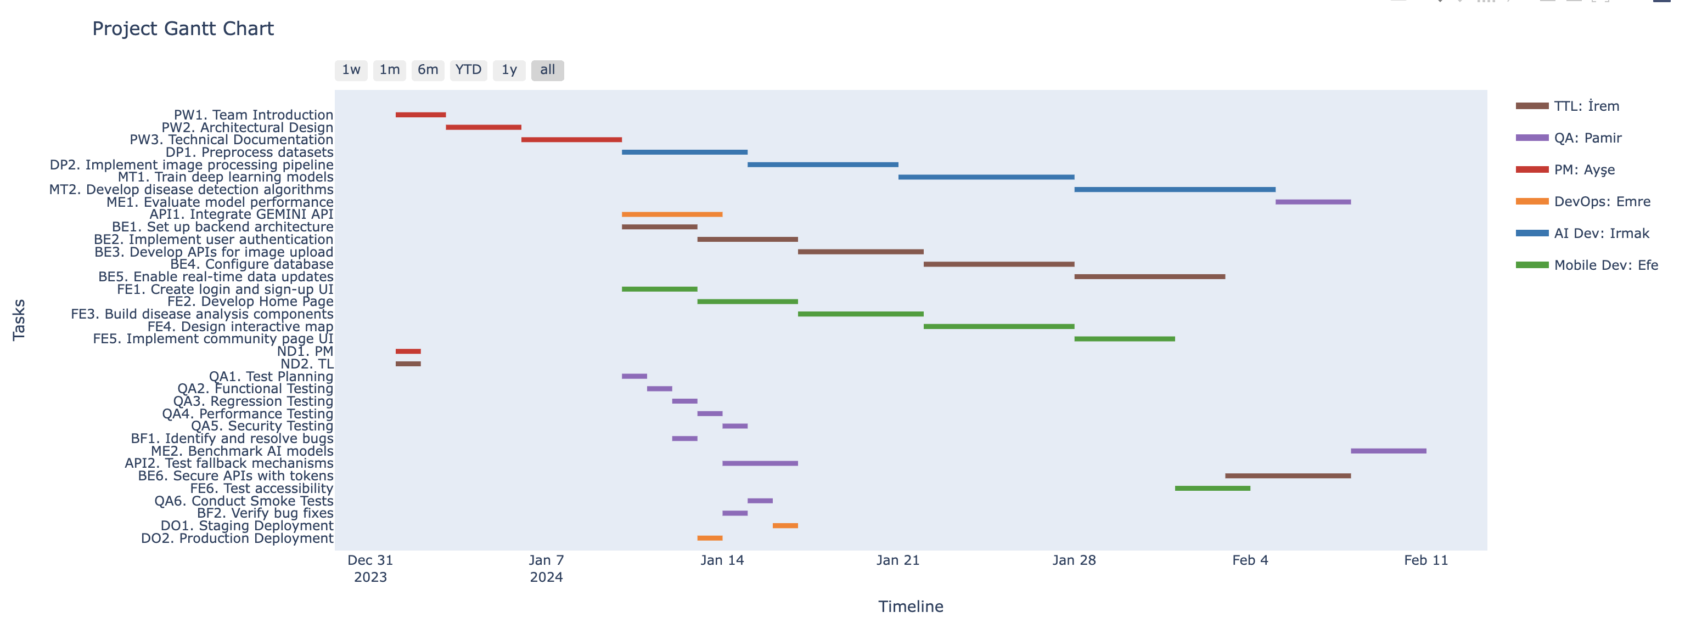
Gantt Chart Creation– Final Result

Slide 30
Risk Identification
OUR APPROACH TO CREATE RISK REGISTER CHART
We sent the corrected SRS, task dependencies, and estimations to GPT and asked it to analyze the potential risks for the project. The following prompt was used to create the risk register chart.
INITIAL PROMPT
Using the provided SRS document, dependency chart, and estimation chart for the project, create a highly detailed risk register in Excel format. The risk register should include the following columns: Risk ID, Risk Description, Category, Likelihood (Low/Medium/High), Impact (Low/Medium/High), Mitigation Plan, Owner, and Status (Open/Closed). Ensure that all potential risks are identified, categorized, and detailed thoroughly, considering the project's dependencies, time estimations, and scope outlined in the SRS. Carefully analyze all the provided documentation and ensure no critical risks are overlooked. Write the detailed risk register in a structured Excel format with precise and comprehensive information.
ITERATIVE PROMPTS
There were no iterative prompts required for this task. GPT successfully created the risk register on the first attempt, providing a clear and accurate representation of potential risks.

Slide 31
Risk Identification – Final Result
Color-Coded Risk Levels:
We categorized and color-coded the risks for better visualization
Red: High Risk, Orange: Middle risk, Green: Low risk

Slide 32
Conclusion
For this term project, we tested three AI tools: ChatGPT, Claude, and Google GEMINI.
Based on our evaluation, the following conclusions were drawn:
ChatGPT emerged as the most efficient tool for tasks like SRS analysis and correction, creating Excel charts, and Gantt chart generation. Its ability to process complex instructions and provide accurate outputs made it a standout choice.
Claude performed exceptionally well in UML diagram creation and context understanding, showcasing its strength in structural and logical tasks.
Google GEMINI, however, was the least effective. It often produced errors and lacked efficiency compared to the other tools, making it less reliable for this project.

Slide 33
Conclusion
AI Tool | Strengths | Weaknesses | Overall Performance
ChatGPT | - SRS analysis and correction | None identified in this context | ⭐⭐⭐⭐⭐ (Best)
 | - Excel chart creation
 | - Gantt chart generation
 | - Processes complex instructions accurately
Claude | - UML diagram creation | Limited capability for numerical or tabular data tasks | ⭐⭐⭐⭐
 | - Context understanding
 | - Strong in structural and logical tasks
Google GEMINI | None | - Frequent errors | ⭐⭐
 |  | - Lacks efficiency
 |  | - Less reliable

Slide 34
THANK YOU

